Slide 1
Atmospheric Gases
8-27-19

Slide 2
Atmospheric Gases
 | Nitrogen and Oxygen | · the two most common gases; found throughout all the layers
 | Ozone | · a form of oxygen found in the stratosphere
 | Water vapor and Carbon dioxide | · important gases for weather conditions; found in the troposphere
 | Trace gases, argon | · play an insignificant role
MENU

Slide 3
Ozone Layer
Atmospheric Gases
Pale blue gas with a strong odor.
90% of all ozone is found in the stratosphere
10% is found in the troposphere
Ozone is extremely important because it is the only gas that absorbs ultraviolet radiation from the Sun and protects the surface of the Earth and people from the damaging effects of UV rays
MENU

Slide 4
Atmospheric Temperatures
 | Differences in temperature separate the layers | · As altitude increases, temperature decreases in the troposphere · The stratosphere is cold except in its upper region where ozone is located · The mesosphere is the coldest layer · Even though the air is thin in the thermosphere, it is very hot · The cold regions of outer space extend from the exosphere
MENU

Slide 5
Atmospheric Pressures
 | The air pressure, the force exerted by the gases pushing on an object, is greatest near the surface of Earth, in the troposphere. | · Air pressure decreases through the layers farther out from the surface as Earth’s pull of gravity decreases. | Troposphere pressure Decreases Exosphere
Troposphere pressure
decreases
MENU

Slide 6
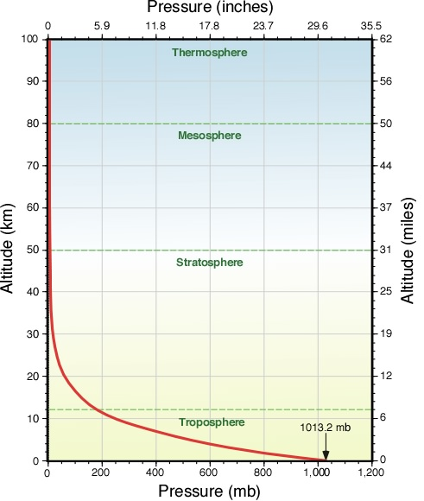
Atmospheric pressure decreases as the altitude increases.

